Slide 1

Heart Attack prediction ML

Slide 2

Agenda
Data Exploring
Data Preprocessing
Pipelines
Best Model
Streamlet

Slide 3
Data Exploring
Number of rows: 445132
Number of columns: 40
Target column : HadHeartAttack
The data set contain Nans

Slide 4
Data Preprocessing
Drop duplicates
Remove nans < 5%
Replace “Never used e-cigarettes in my entire life” and “Not at all (right now)” to “Not at all“ in ECigaretteUsage column
Remove columns :
'WeightInKilograms’ (Exists in BMI)
'State’
'RaceEthnicityCategory’
'HadAsthma’
'HadSkinCancer'

Slide 5
pipeline
Split data Train ,Test
Change y from text to 0 “no”, 1 “yes”
Imbalanced Target HadHeartAttack:
Class weight calculation:
XGBoost : XGBoost_scale_pos_weight = negative / positive
CatBoost:
w0 = total / (2 * negative)
w1 = total / (2 * positive)
HadHeartAttack
0 | 276635
1 | 15199

Slide 6
pipeline
Categorical pipeline
col not in ['TetanusLast10Tdap','AgeCategory’]
SimpleImputer : most_frequent
OneHotEncoder
["TetanusLast10Tdap"]
SimpleImputer: unKnown
OneHotEncoder
AgeCategory
OrdinalEncoder

Slide 7
pipeline
numeric pipeline
SimpleImputer : median
RobustScaler
ColumnTransformer
Models Pipeline:
Models :
[
('Logistic Regression', LogisticRegression(class_weight="balanced",random_state= 42, n_jobs= -1)),
('Gaussian NB', GaussianNB()),
('Decision Tree', DecisionTreeClassifier(class_weight="balanced",random_state= 42)),
('Random Forest', RandomForestClassifier(class_weight="balanced",random_state= 42, n_jobs= -1)),
('XGBoost', XGBClassifier(scale_pos_weight=XGBoost_scale_pos_weight,random_state=42,n_jobs=-1)),
('CatBoost', CatBoostClassifier(allow_writing_files=False,class_weights=[w0, w1], random_state=42,thread_count=-1)),
('LightGBM', LGBMClassifier(class_weight='balanced',random_state=42, n_jobs=-1))
]

Slide 8
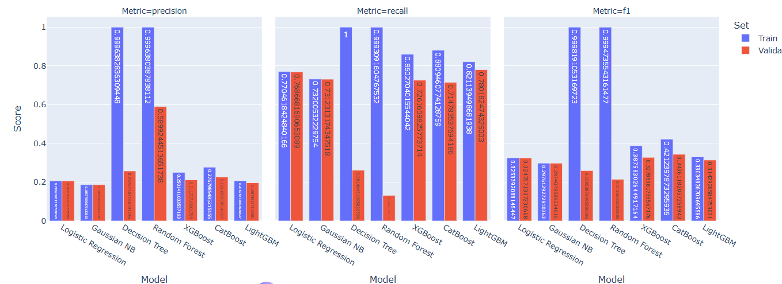
pipeline
Models Pipeline:

Slide 9
pipeline
Models Pipeline:
Models (SMOT) :
[
('Logistic Regression', LogisticRegression(class_weight="balanced",random_state= 42, n_jobs= -1)),
('Gaussian NB', GaussianNB()),
('Decision Tree', DecisionTreeClassifier(class_weight="balanced",random_state= 42)),
('Random Forest', RandomForestClassifier(class_weight="balanced",random_state= 42, n_jobs= -1)),
('XGBoost', XGBClassifier(scale_pos_weight=XGBoost_scale_pos_weight,random_state=42,n_jobs=-1)),
('CatBoost', CatBoostClassifier(allow_writing_files=False,class_weights=[w0, w1], random_state=42,thread_count=-1)),
('LightGBM', LGBMClassifier(class_weight='balanced',random_state=42, n_jobs=-1))
]

Slide 10
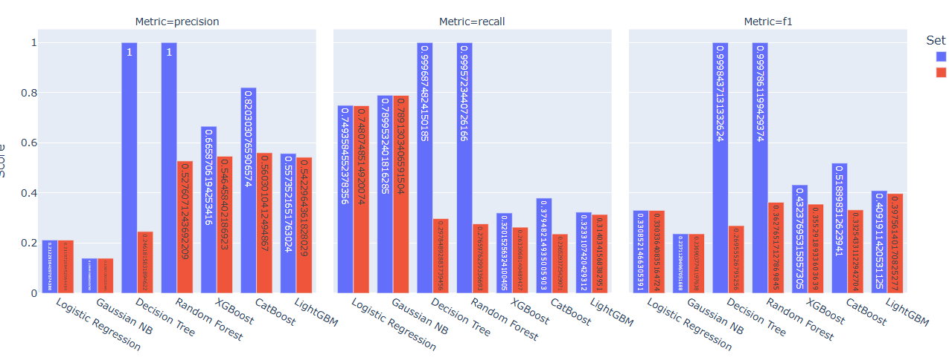
pipeline
Models Pipeline:
Models (SMOT) :

Slide 11
pipeline
Models Pipeline:
Models (Hyper Parametr Randomized search) :
[('Logistic Regression', LogisticRegression(class_weight="balanced",random_state= 42, n_jobs= -1), {"Model__C":[0.01, 0.1, 1, 10, 100],"Model__penalty":['l1', 'l2']}),
('Random Forest', RandomForestClassifier(class_weight="balanced",random_state= 42, n_jobs= -1), {"Model__n_estimators": [2,3,5,10,50,100, 300, 500],"Model__max_depth": [2,5, 10, 15,21 ]} ),
('XGBoost', XGBClassifier(scale_pos_weight=XGBoost_scale_pos_weight,random_state=42, n_jobs=-1), { "Model__n_estimators": [2,3,5,10,50,100,500],"Model__max_depth": [3, 5, 10, 15,21],"Model__reg_lambda":[1,2,5,0.1,0.2,0.5]} ),
('LightGBM', LGBMClassifier(class_weight='balanced',random_state=42, n_jobs=-1), {"Model__n_estimators": [2,3,5,10,50,100,200, 400, 600]})
]

Slide 12
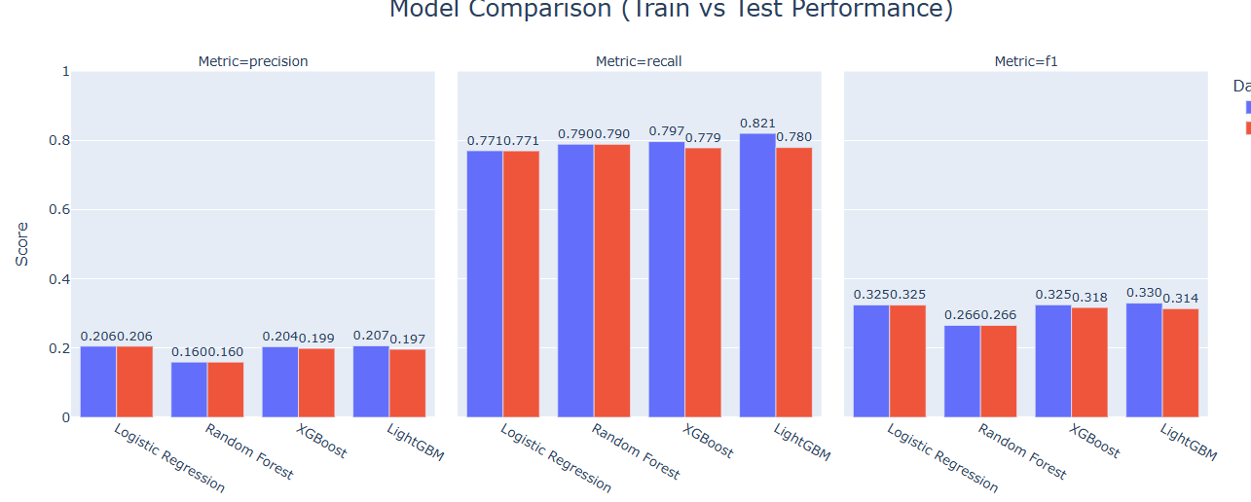
pipeline
Models Pipeline:
Models (Hyper Parameter Randomized search) :

Slide 13
pipeline
Models Pipeline:
Feature Selection
VarianceThreshold :(threshold=0)
('Logistic Regression', LogisticRegression(class_weight="balanced",random_state= 42, n_jobs= -1)),
('Gaussian NB', GaussianNB()),
('Decision Tree', DecisionTreeClassifier(class_weight="balanced",random_state= 42)),
('Random Forest', RandomForestClassifier(class_weight="balanced",random_state= 42, n_jobs= -1)),
('XGBoost', XGBClassifier(scale_pos_weight=XGBoost_scale_pos_weight,random_state=42,n_jobs=-1)),
('CatBoost', CatBoostClassifier(allow_writing_files=False,class_weights=[w0, w1], random_state=42,thread_count=-1
('LightGBM', LGBMClassifier(class_weight='balanced',random_state=42, n_jobs=-1))

Slide 14
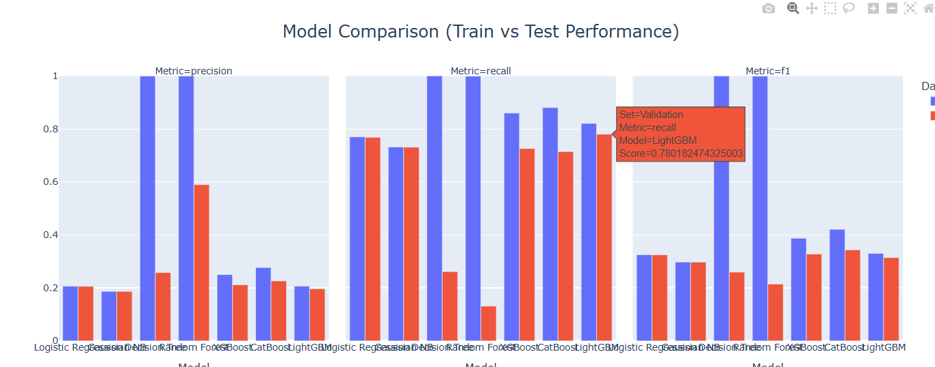
pipeline
Models Pipeline:
Feature Selection
VarianceThreshold :(threshold=0)

Slide 15
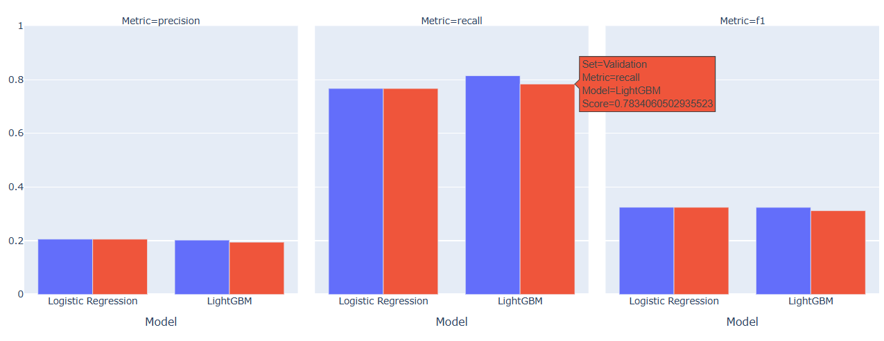
pipeline
Models Pipeline:
Feature Selection
KBSelect: with
('Logistic Regression', LogisticRegression(class_weight="balanced",random_state= 42, n_jobs= -1)),
('LightGBM', LGBMClassifier(class_weight='balanced',random_state=42, n_jobs=-1))

Slide 16
pipeline
Models Pipeline:
Feature Selection
Embedded methods
models = [
('Logistic Regression', LogisticRegression(class_weight="balanced",random_state= 42, n_jobs= -1)),
('Decision Tree', DecisionTreeClassifier(class_weight="balanced",random_state= 42)),
('Random Forest', RandomForestClassifier(class_weight="balanced",random_state= 42, n_jobs= -1)),
('XGBoost', XGBClassifier(scale_pos_weight=XGBoost_scale_pos_weight,random_state=42,n_jobs=-1)),
('CatBoost', CatBoostClassifier(allow_writing_files=False,class_weights=[w0, w1], random_state=42,thread_count=-1)), ('LightGBM', LGBMClassifier(class_weight='balanced',random_state=42, n_jobs=-1))
]

Slide 17
Best Model
Light GPM without any further processing
validation Recall 0.78
test Recall 0.81

Slide 18
Streamlet
https://awasseem-epsilon-finalprojectmlheartattack-streamlet-pzddwy.streamlit.app/

Slide 19
Dynamic delivery
Learn to infuse energy into your delivery to leave a lasting impression
One of the goals of effective communication is to motivate your audience
Impact factor | Measurement | Target | Achieved
Audience interaction | Percentage (%) | 85 | 88
Knowledge retention | Percentage (%) | 75 | 80
Post-presentation surveys | Average rating | 4.2 | 4.5
Referral rate | Percentage (%) | 10 | 12
Collaboration opportunities | # of opportunities | 8 | 10

